Slide 1
TV-TENNIS
Authors:
Blaginin Artyom
Valikov Nikolay
Khlebnikov Vadim

Slide 2
CONTENTS OF OUR PROJECT
Have you ever played tennis?
Hardware:
Playing Field and Videochip
Kinematic Controller
Software
CDM-8 and Right Bat Control
Further developments

Slide 3
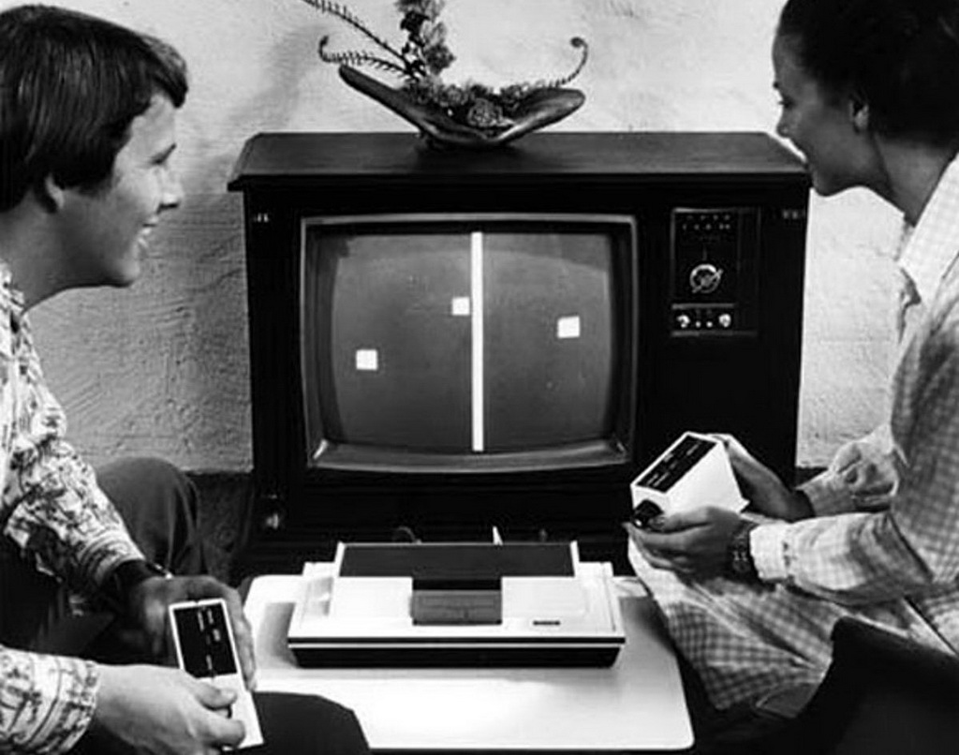
HAVE YOU EVER PLAYED TENNIS?

Slide 4
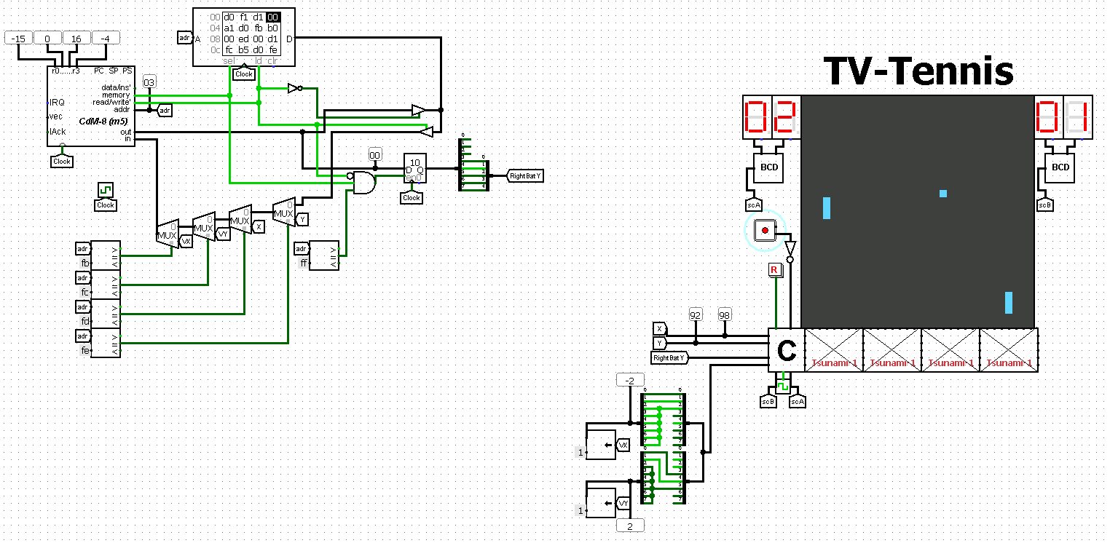
The main scheme
The main view of the circuit: on the left - the CDM-8 processor controlling the right racket, on the right – the playing field

Slide 5
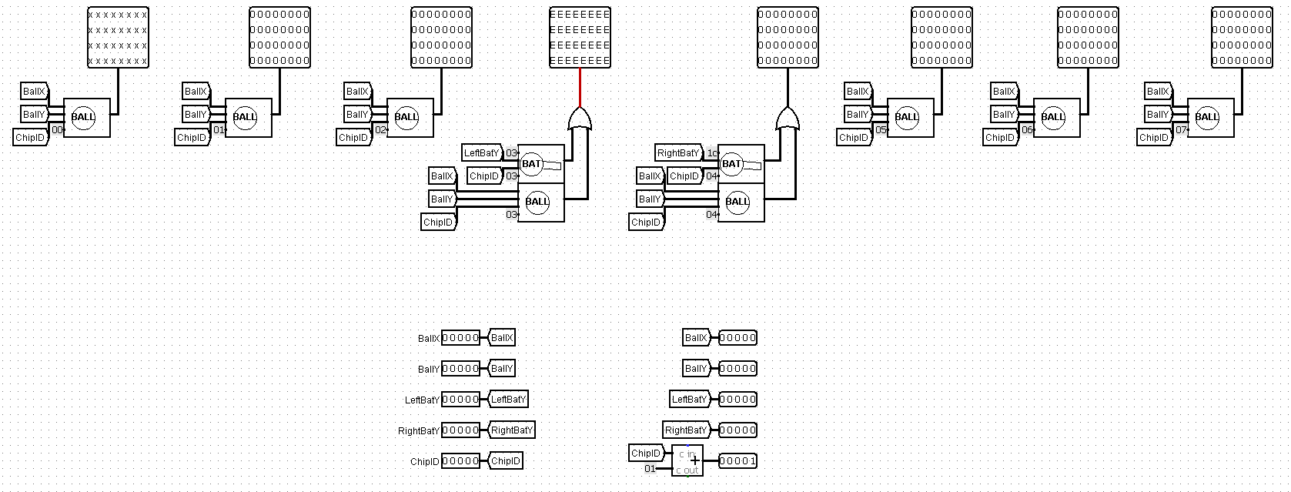
Videochip
“Tsunami-1” video chip, which draws a picture of the game

Slide 6
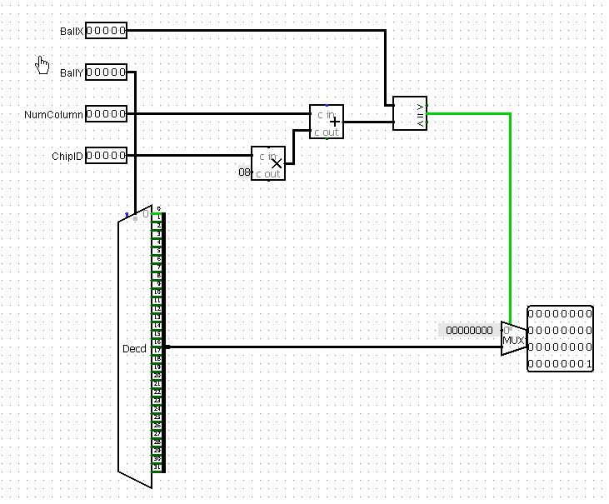
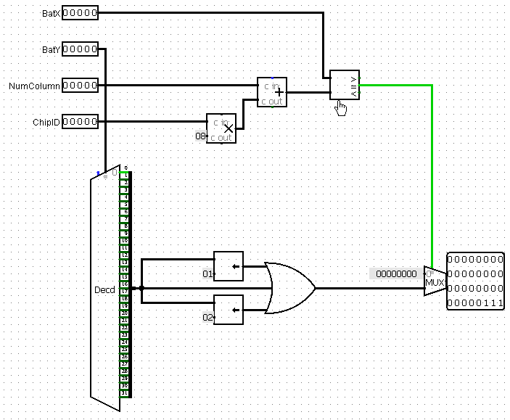
BALL and BAT chips
Chip “BALL”, which draws the ball
Chip “BAT”, which draws the bat

Slide 7
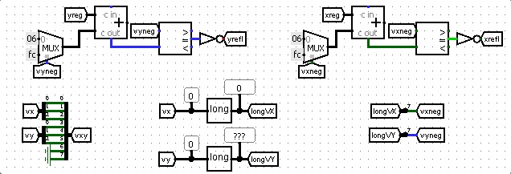
Kinematic controller
Velocity and Reflect modules

Slide 8
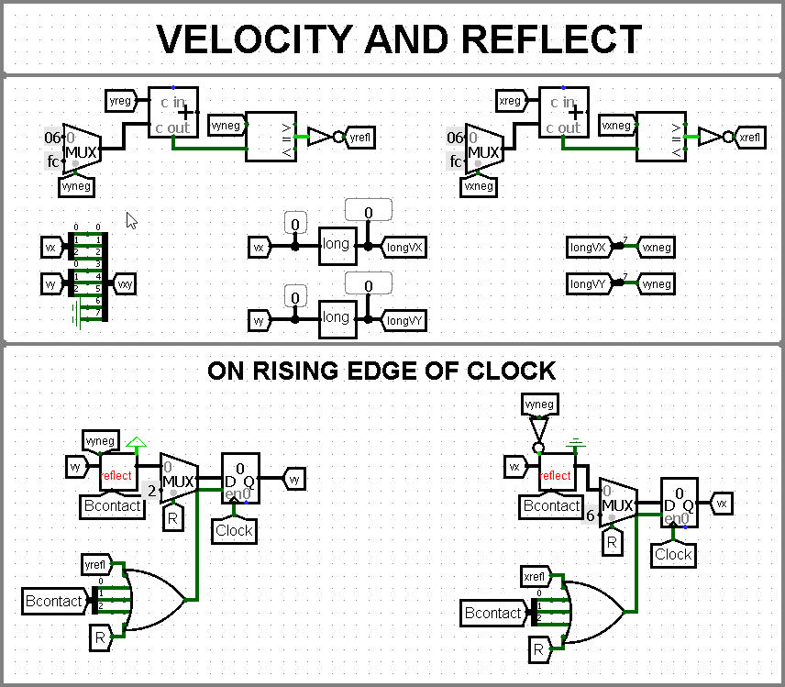
Kinematic controller
Changing velocity of the ball

Slide 9
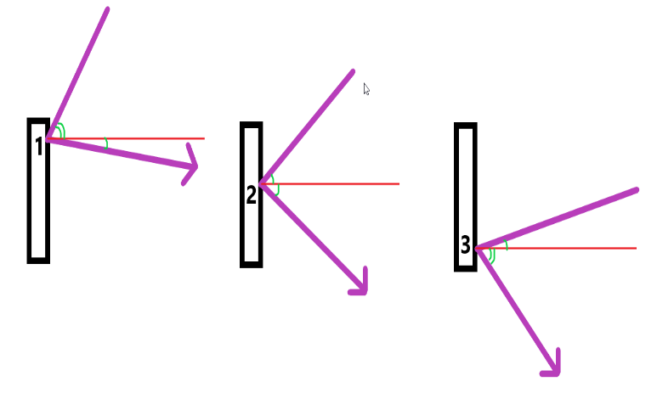
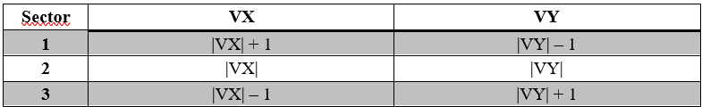
Kinematic controller
Ball physics, depending on the sector of the ball hit

Slide 10
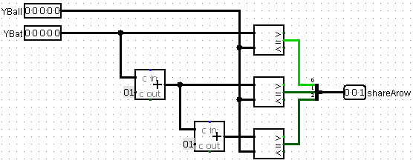
Kinematic controller
Inrange module which checks if the ball has hit the bat

Slide 11
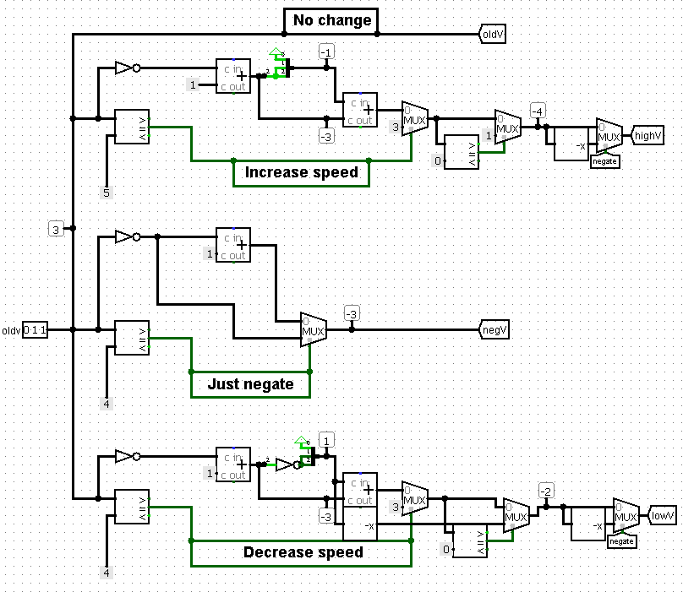
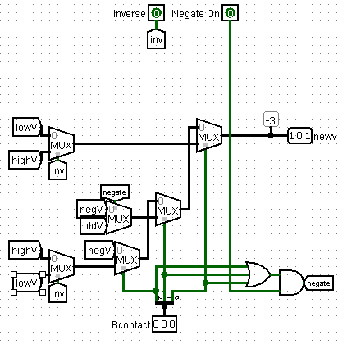
Kinematic controller
Reflect module

Slide 12
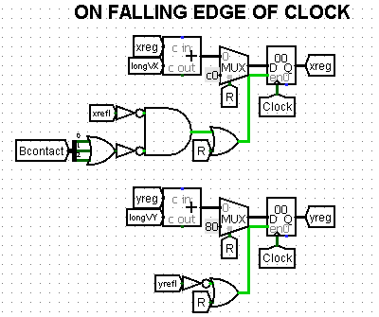

Kinematic controller
Updating coordinates of the ball

Slide 13
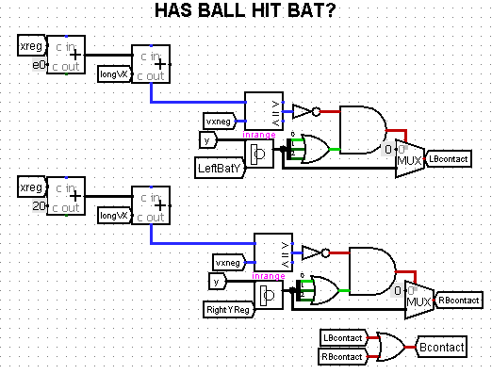
Kinematic controller
Checking if the ball hit the wall

Slide 14
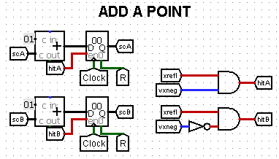
Kinematic controller
Adding a point

Slide 15
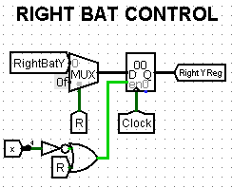
Kinematic controller
Right bat control (this module ensures that the bat stops in the right half of the screen)

Slide 16
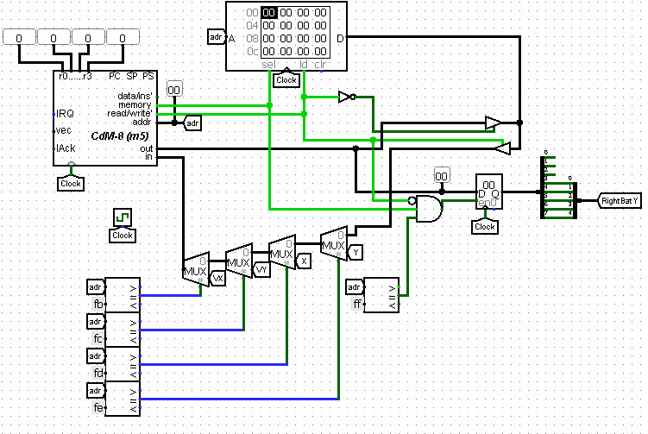
Artificial intelligence
Memory Mapped IO

Slide 17
Artificial intelligence
Algorithm for calculating the final coordinate:
1) Wait until the ball flies to the right racket;
2) Using the distance to the right racket calculate the final Y coordinate where the ball will arrive;
3) Move the racket to the received coordinate

Slide 18
Further developments
Optimization of coordinate calculation
Twisted punches
Multiball game mode

Slide 19
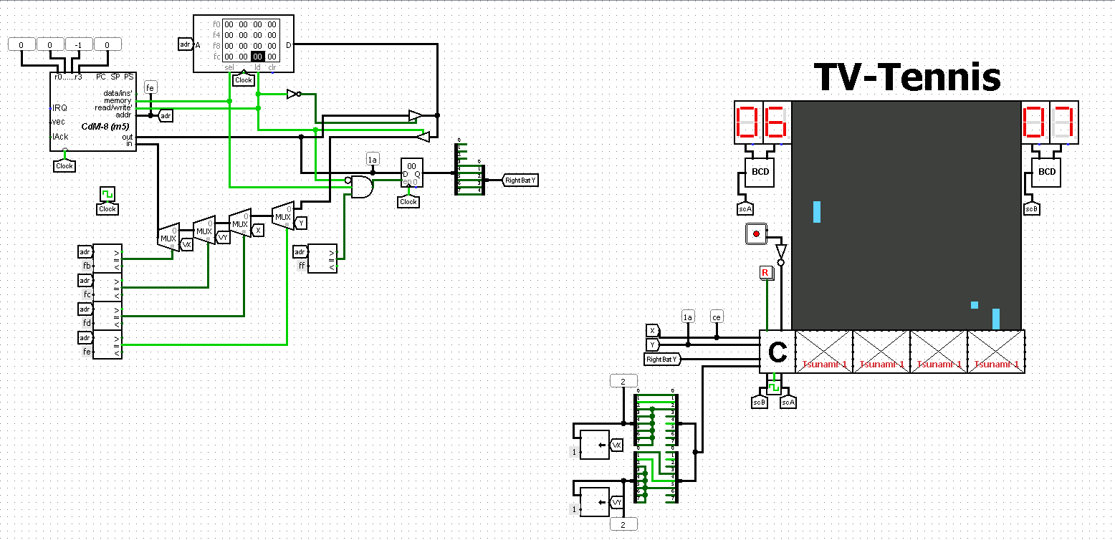
THANK YOU FOR YOUR ATTENTION

